Slide 1
Bot Framework Workshop

Slide 2

Technology Needed today Node
Installs
Node.js (and npm)
Ngrok
GIT (not necessary but helpful)
VS Code (for node)
Visual Studio 2015 & Bot Template (for C#)
Signups needed
MSID
BotFramework.com
LUIS – Language Understanding Intelligent Services

Slide 3
Understanding the Bot Framework

Slide 4
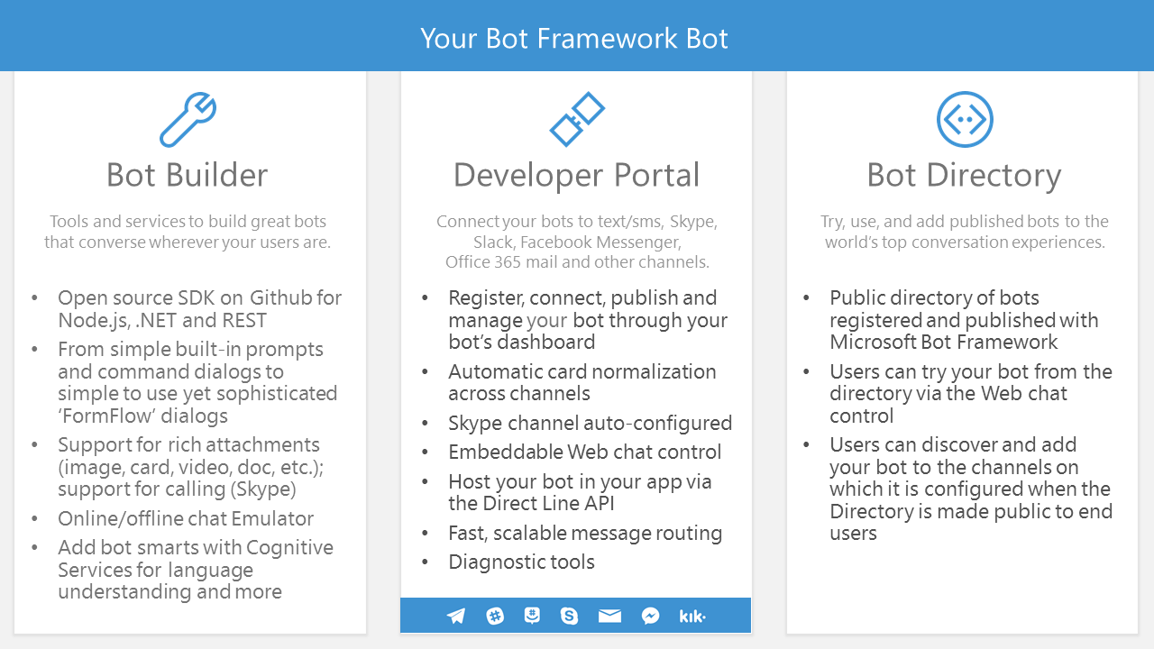

Slide 5
An x-ray of a typical bot
Conversation Canvas/Channels
Your code goes here
Web Chat
Bot Connector Service
Email
Message input <> output
State Management
Facebook
GroupMe
Your bot code
API, SDK calls
Kik
Skype
Bot Builder SDK
Slack
+ Microsoft Cognitive Services
Telegram
Other services, APIs,
Databases, Azure Machine Learning, Azure Search, etc…
Natural Language
Translation
Vision/Face
Emotion
Twilio (SMS)
…
Direct Line…
Speech
Entity Extraction
Search
Knowledge API
…
…
…

Slide 6














Bot Communication
User
Channel
Bot

Slide 7
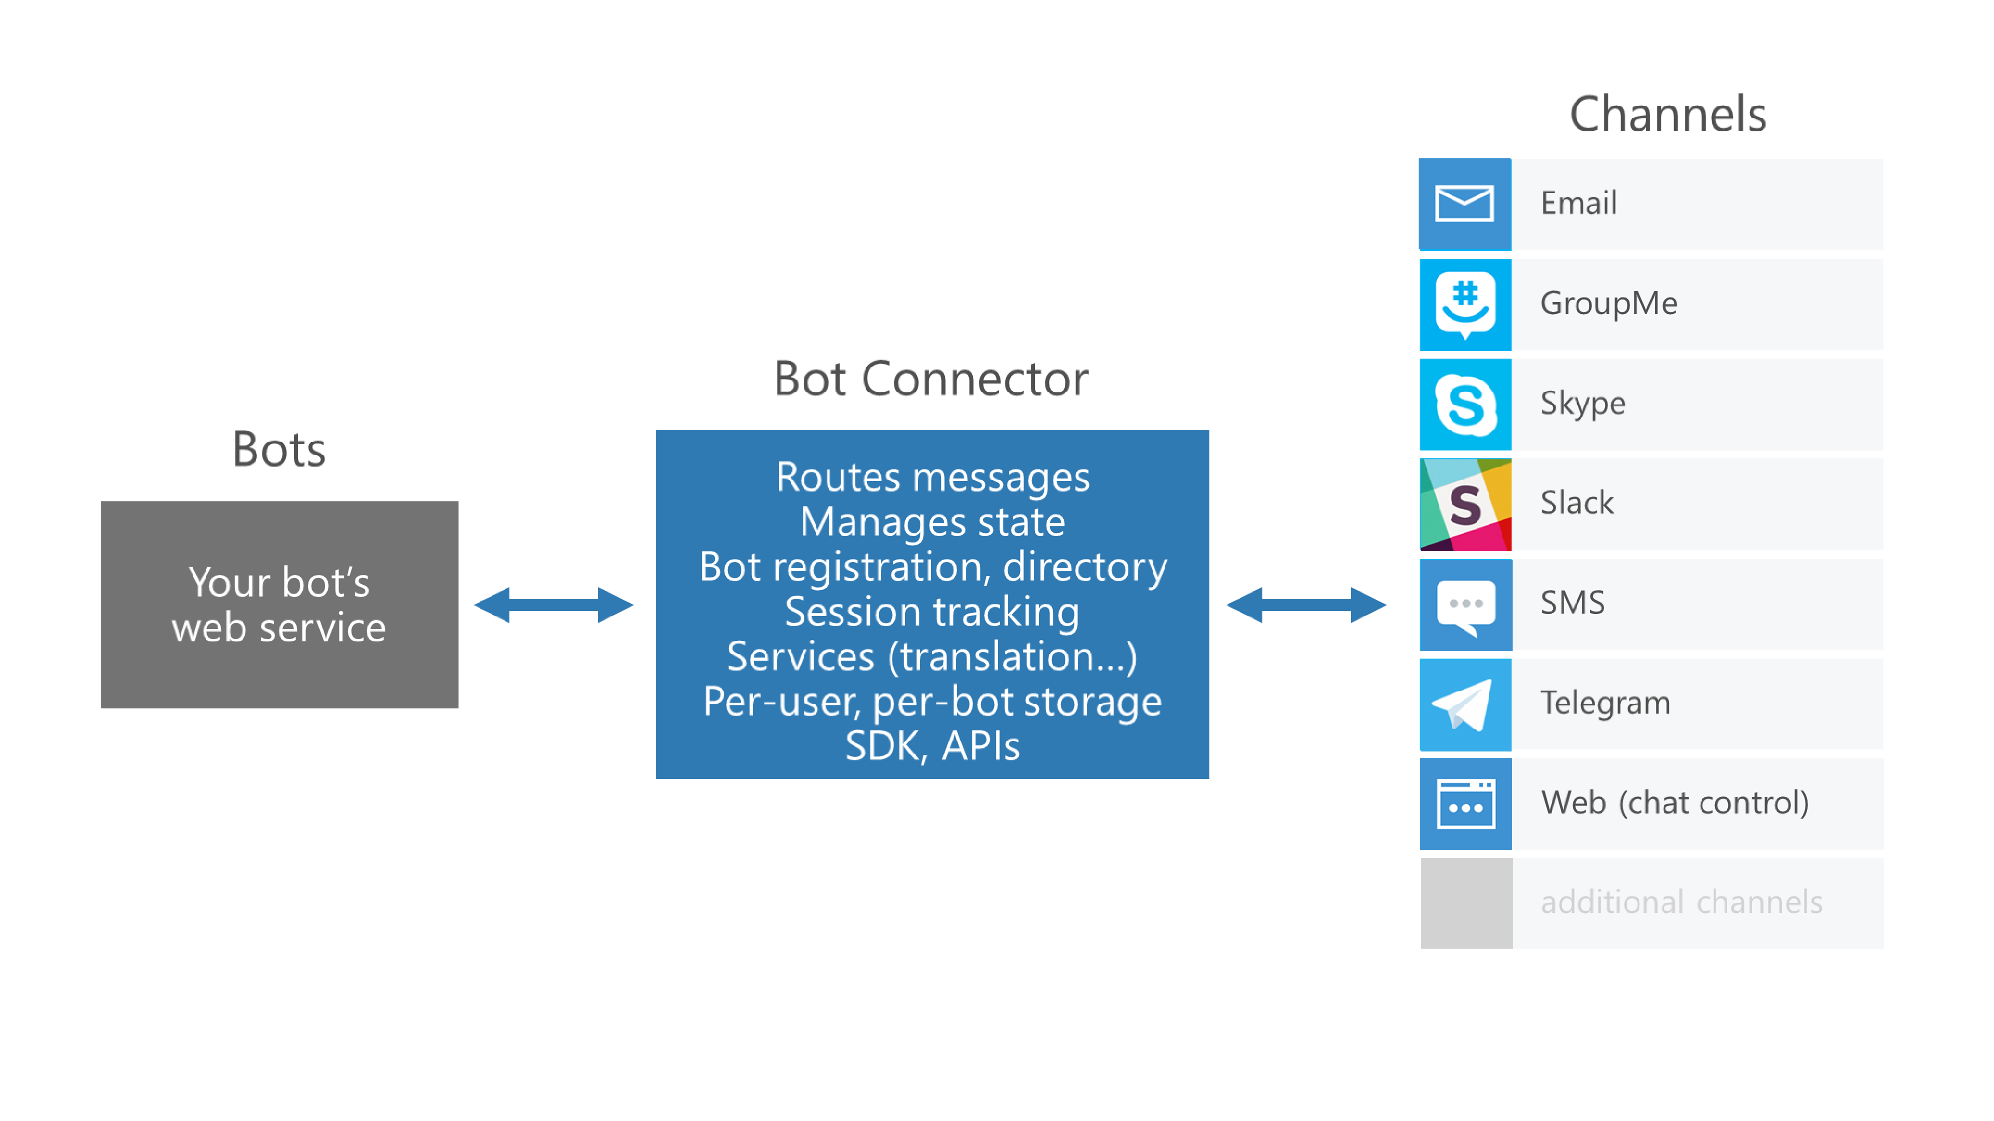

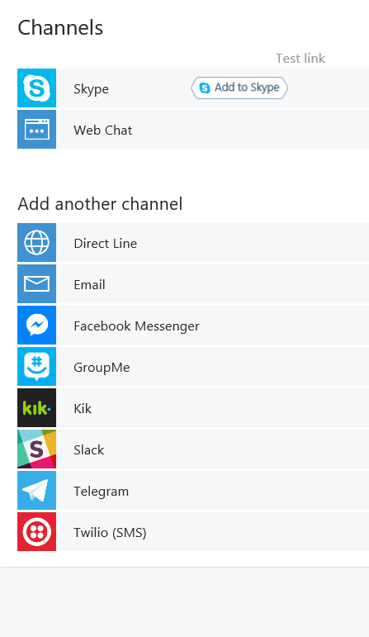

Slide 8



Connector Service
Connector Service
Bot
Channel
Activity JSON
Channel JSON

Slide 9
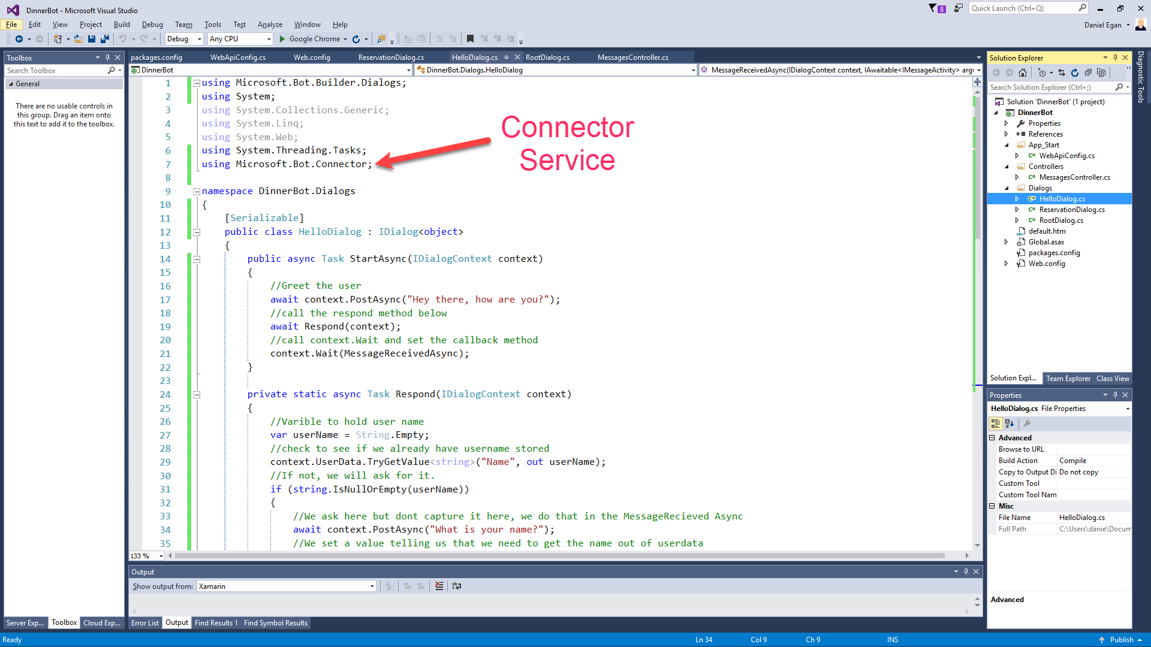

Slide 10
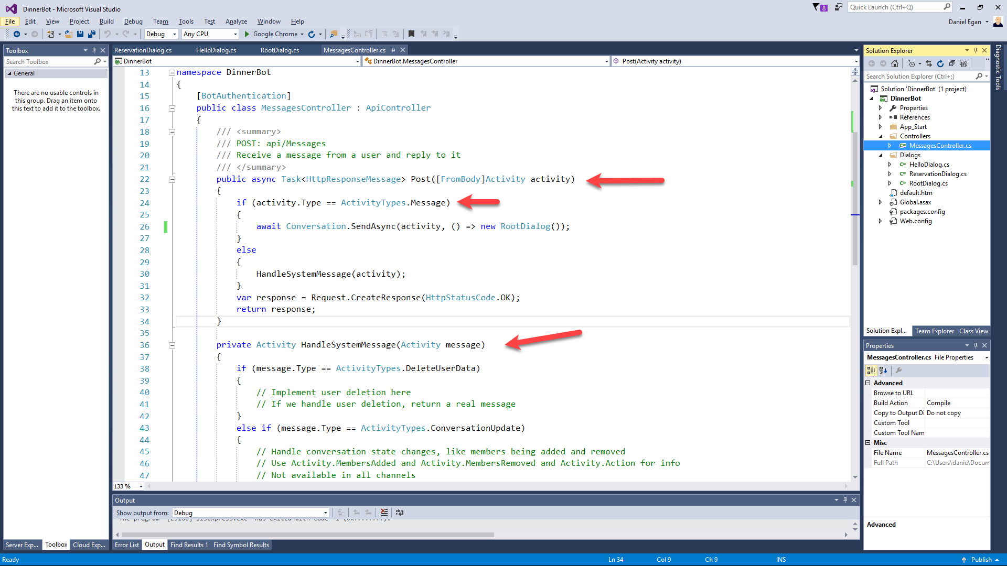

Slide 11
Understanding Dialogs

Slide 12

Dialogs
User
Bot
Hi
Hi I'm Dinner Bot how can I help you today?
I would like to reserve a table.
Great, lets get started.

Slide 13
Dialogs = Routing
Hi
How can I help you
I want to reserve a table
Do we know the user?
No
Yes
GetUserInfoDialog
ReservationDialog

Slide 14
Dialog Chain
Conversation
Introduction Dialog
User Info Dialog
Reservation Dialog
C# Chaining or Context.Call
node beginDialog/endDialog or waterfall

Slide 15
Persisting Data
userData
stores information globally for the user across all conversations.
conversationData
stores information globally for a single conversation. This data is visible to everyone within the conversation so care should be used to what’s stored there. It’s disabled by default and needs to be enabled using the bots persistConversationData setting.
privateConversationData
stores information globally for a single conversation but its private data for the current user. This data spans all dialogs so it’s useful for storing temporary state that you want cleaned up when the conversation ends.
dialogData
persists information for a single dialog instance. This is essential for storing temporary information in between the steps of a waterfall.

Slide 16
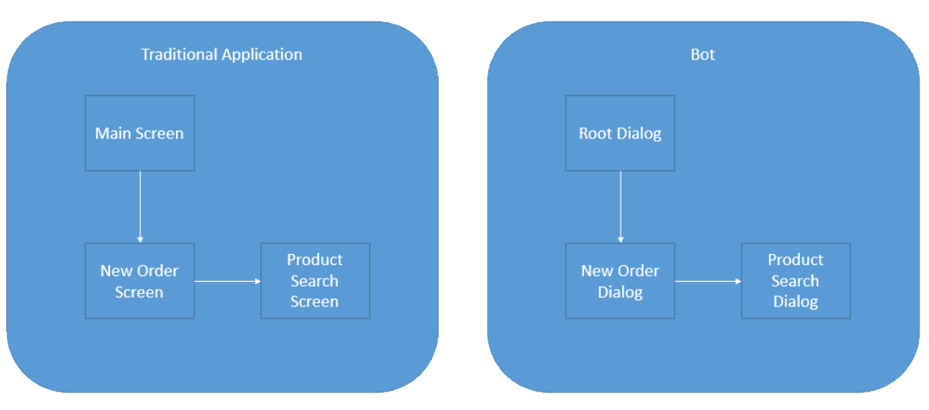
Dialogs are for bots like screens are for apps
They separate concerns and organize flows, exactly the same way:

Slide 17
Dialogs are serialized into stacks
This is how we know how to navigate “back”
Users won’t necessarily think that way
…
Dialog 2
Dialog 1
Root Dialog

Slide 18
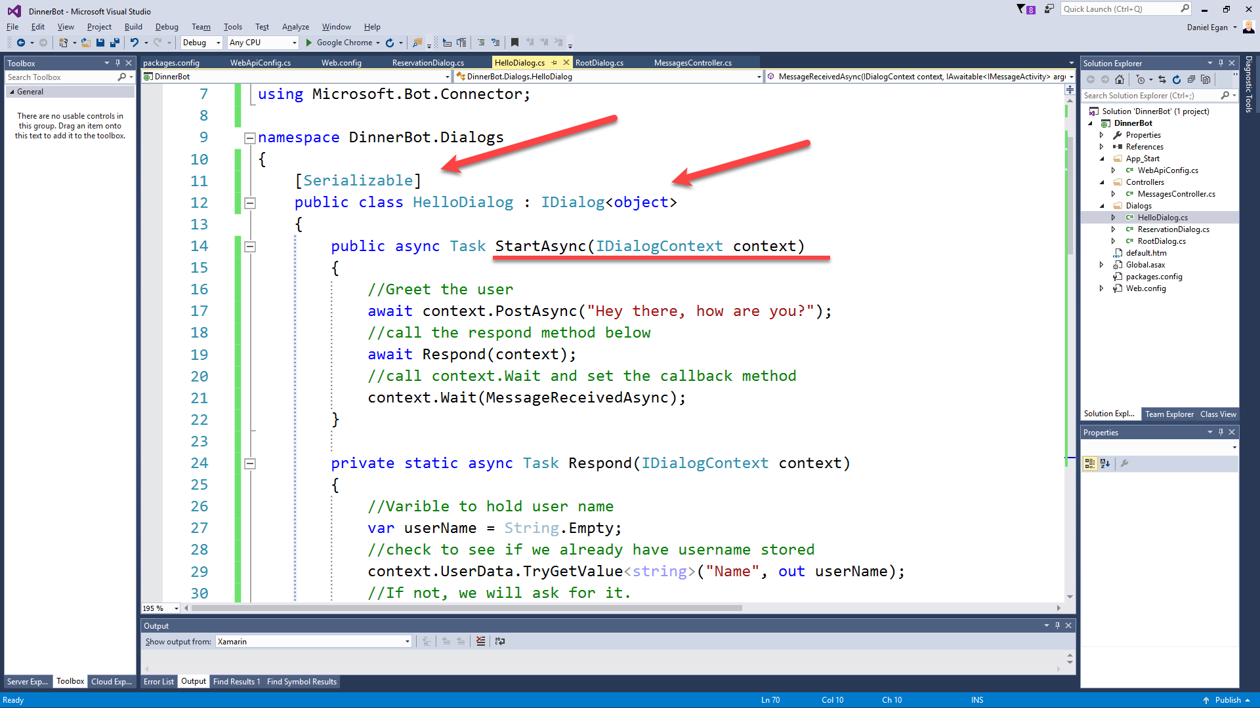

Slide 19
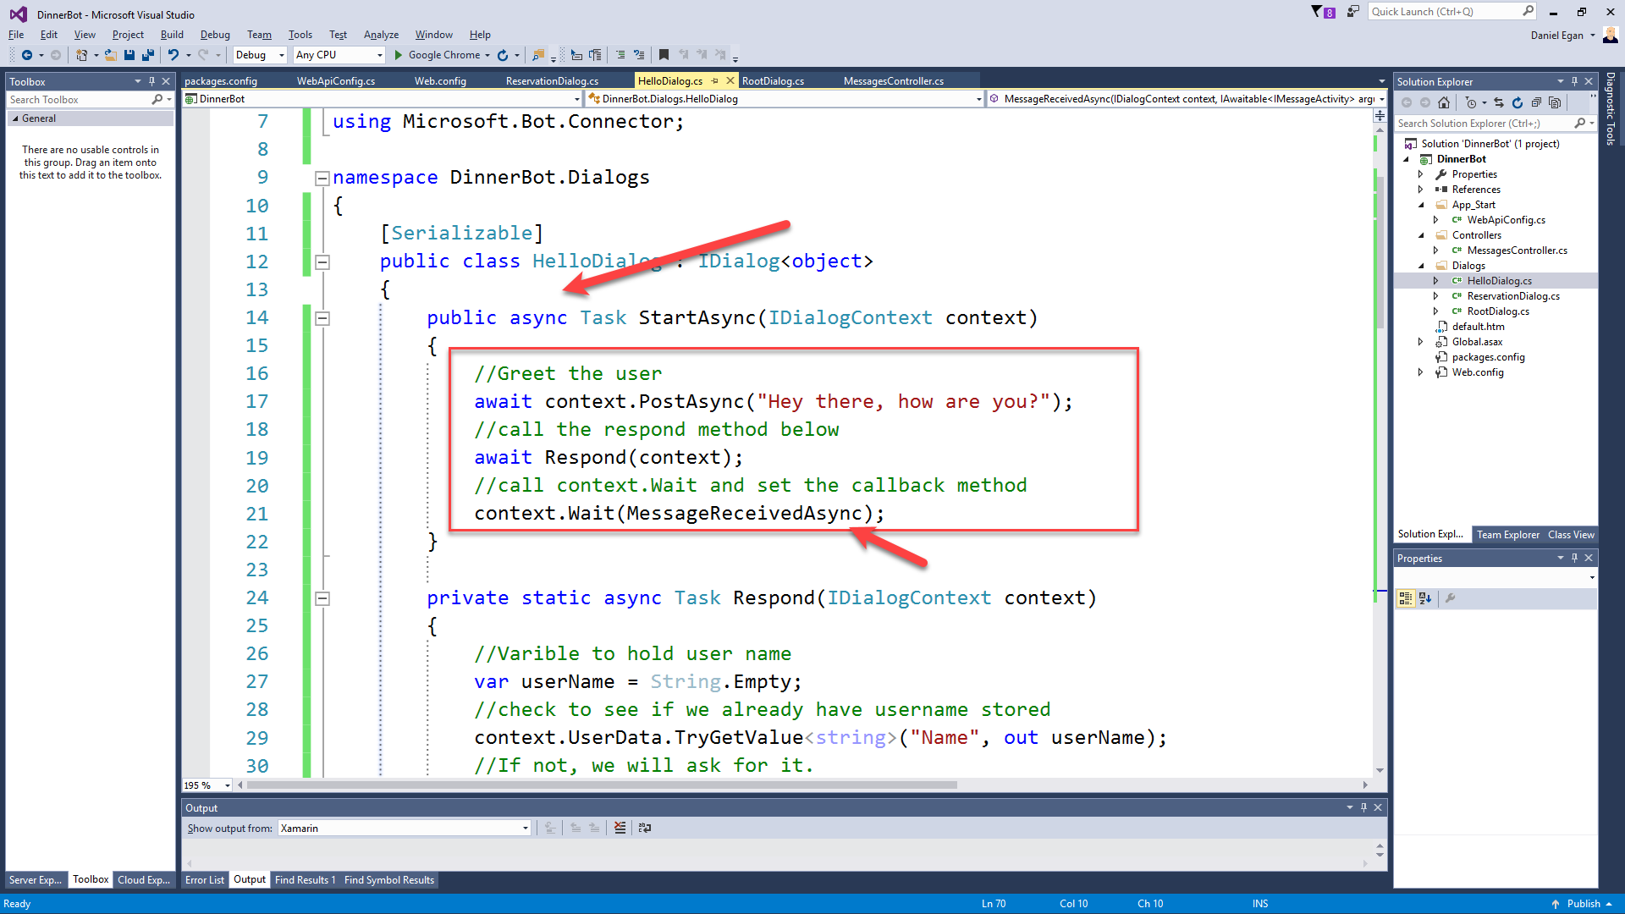

Slide 20
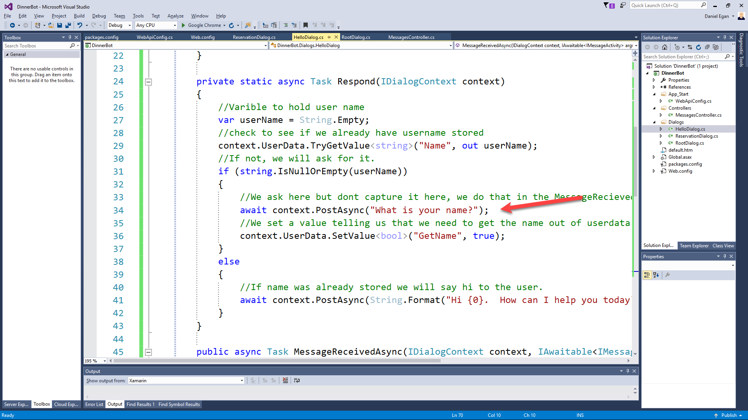

Slide 21
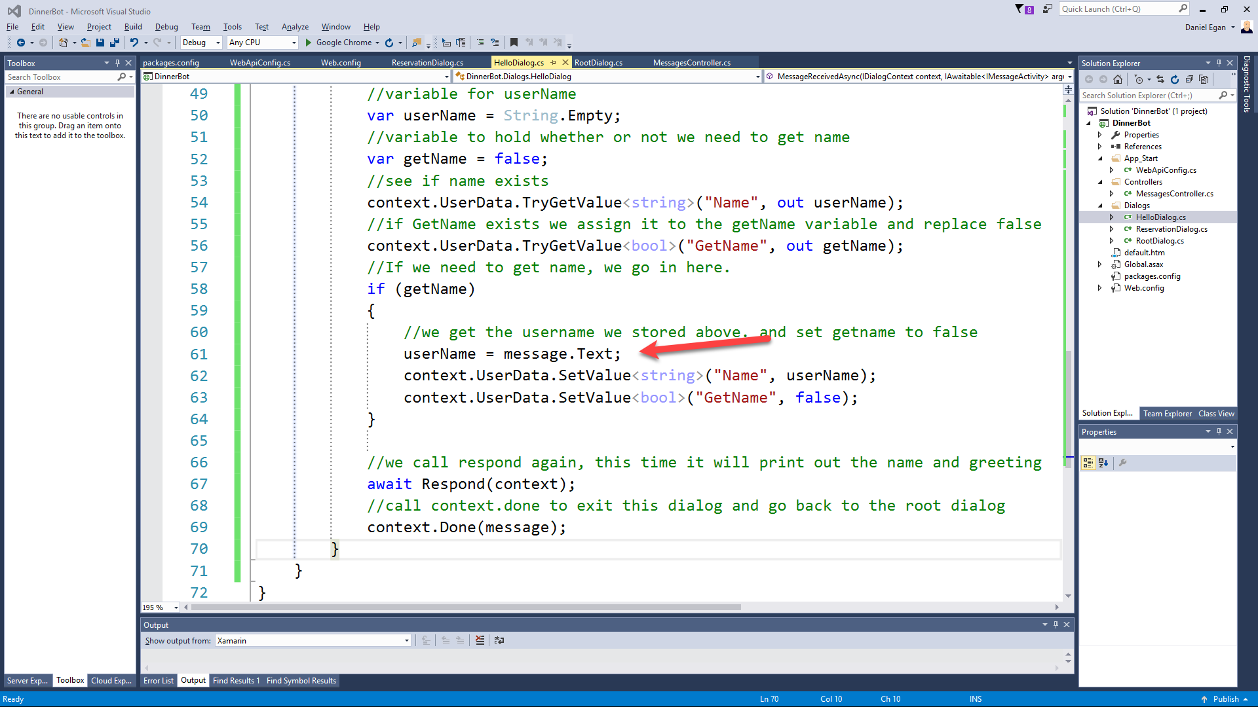

Slide 22
Hands On LAB
Exercise 1 – Basic Bot Builder & Exercise 2 – Creating Dialogs

Slide 23
Form Flow

Slide 24
Form Flow
(*** only in C# SDK)
What Date would you like reservations for?
User
Bot
12/14/17
For how many people?
4
What time?

Slide 25
Form Flow
(*** only in C# SDK)
What Date would you like reservations for?
User
Bot
12/14/17
For how many people?
Wait I mean 2/14/17
?????????

Slide 26
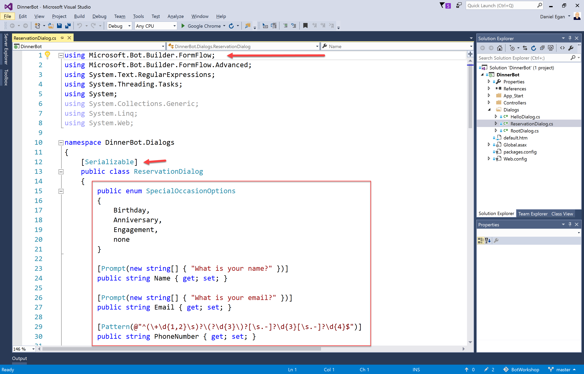

Slide 27
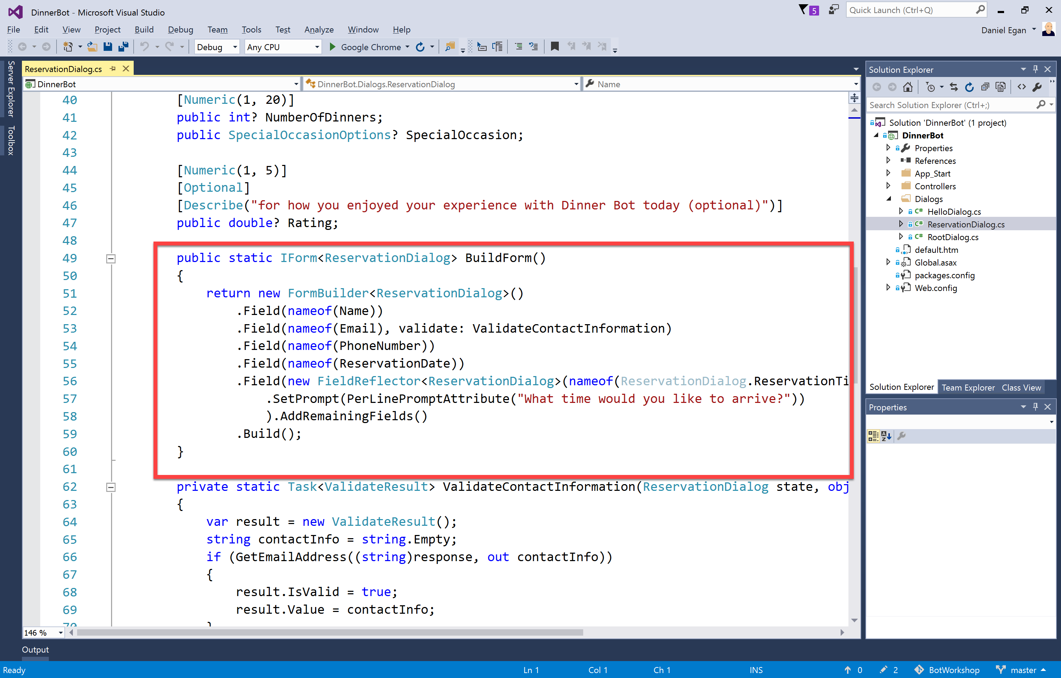

Slide 28
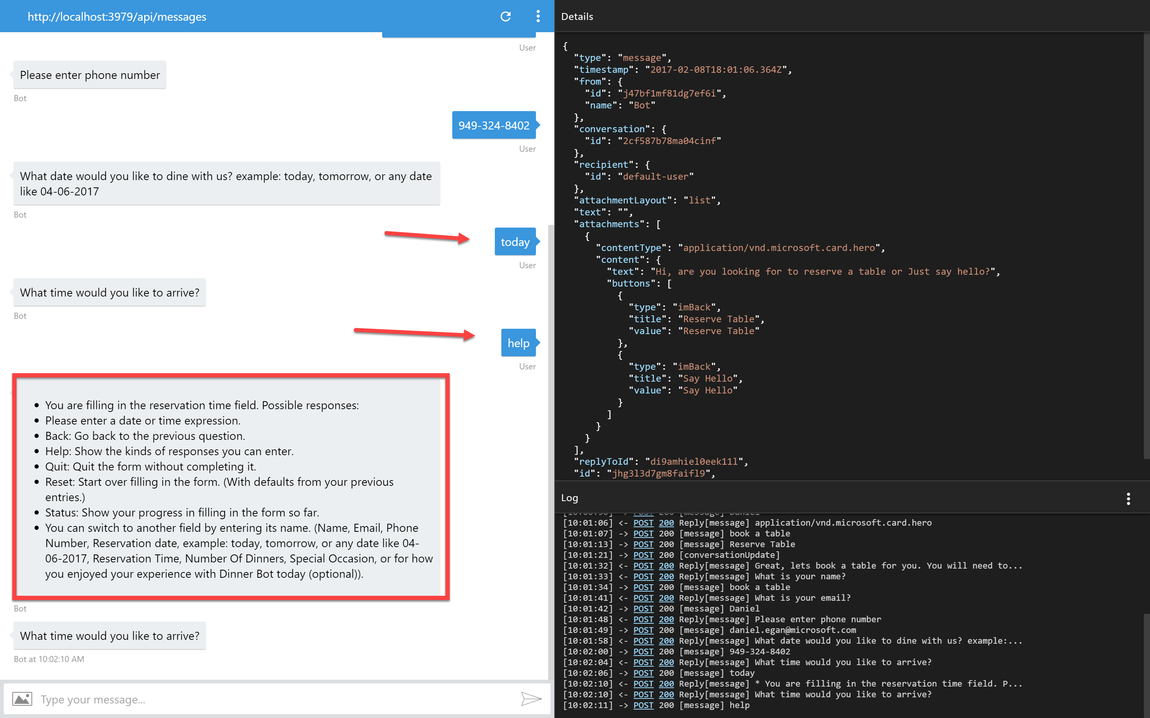
Add slide showing bot handle things.

Slide 29
Hands On LAB
Exercise 3 – Form Flow

Slide 30
Carousels, Cards, and Adaptive

Slide 31
Hands On LAB
Exercise 4 – Carousels Cards and Adaptive Cards

Slide 32
Intent Dialogs
Using Natural Language Processing

Slide 33
Why Bots are like text based Adventure Games

Slide 34
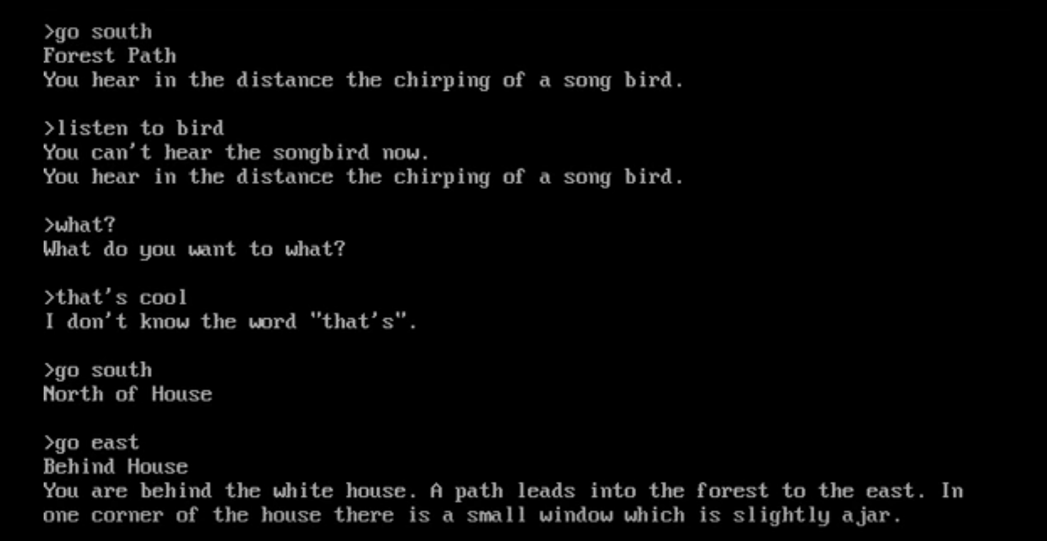

Slide 35
NLP To the Rescue

Slide 36
Why is NLP so hard?

Slide 37
“I saw a man on a hill with a telescope.”
Simple statement?
There’s a man on a hill, and I’m watching him with my telescope.
There’s a man on a hill, who I’m seeing, and he has a telescope.
There’s a man, and he’s on a hill that also has a telescope on it.
I’m on a hill, and I saw a man using a telescope.
Notes:
http://blog.algorithmia.com/introduction-natural-language-processing-nlp/
https://www.youtube.com/watch?v=8S3qHHUKqYk
Tons of stuff here : http://blog.algorithmia.com/introduction-natural-language-processing-nlp/
Human generated language.
spam detection
Millennial speak
On fleek
Bae
Dabbing
Yolo
Throwing Shade

Slide 38
Think about a bot used to answer customers questions about laptops and accessories.
Has my order number 15489 been shipped yet?
How fast is the Surface 3?
Do you sell Acer Laptops and drives?
What kind of a display is on Surface 4
Notes:
http://blog.algorithmia.com/introduction-natural-language-processing-nlp/
https://www.youtube.com/watch?v=8S3qHHUKqYk
Tons of stuff here : http://blog.algorithmia.com/introduction-natural-language-processing-nlp/
Human generated language.
spam detection
Millennial speak
On fleek
Bae
Dabbing
Yolo
Throwing Shade

Slide 39
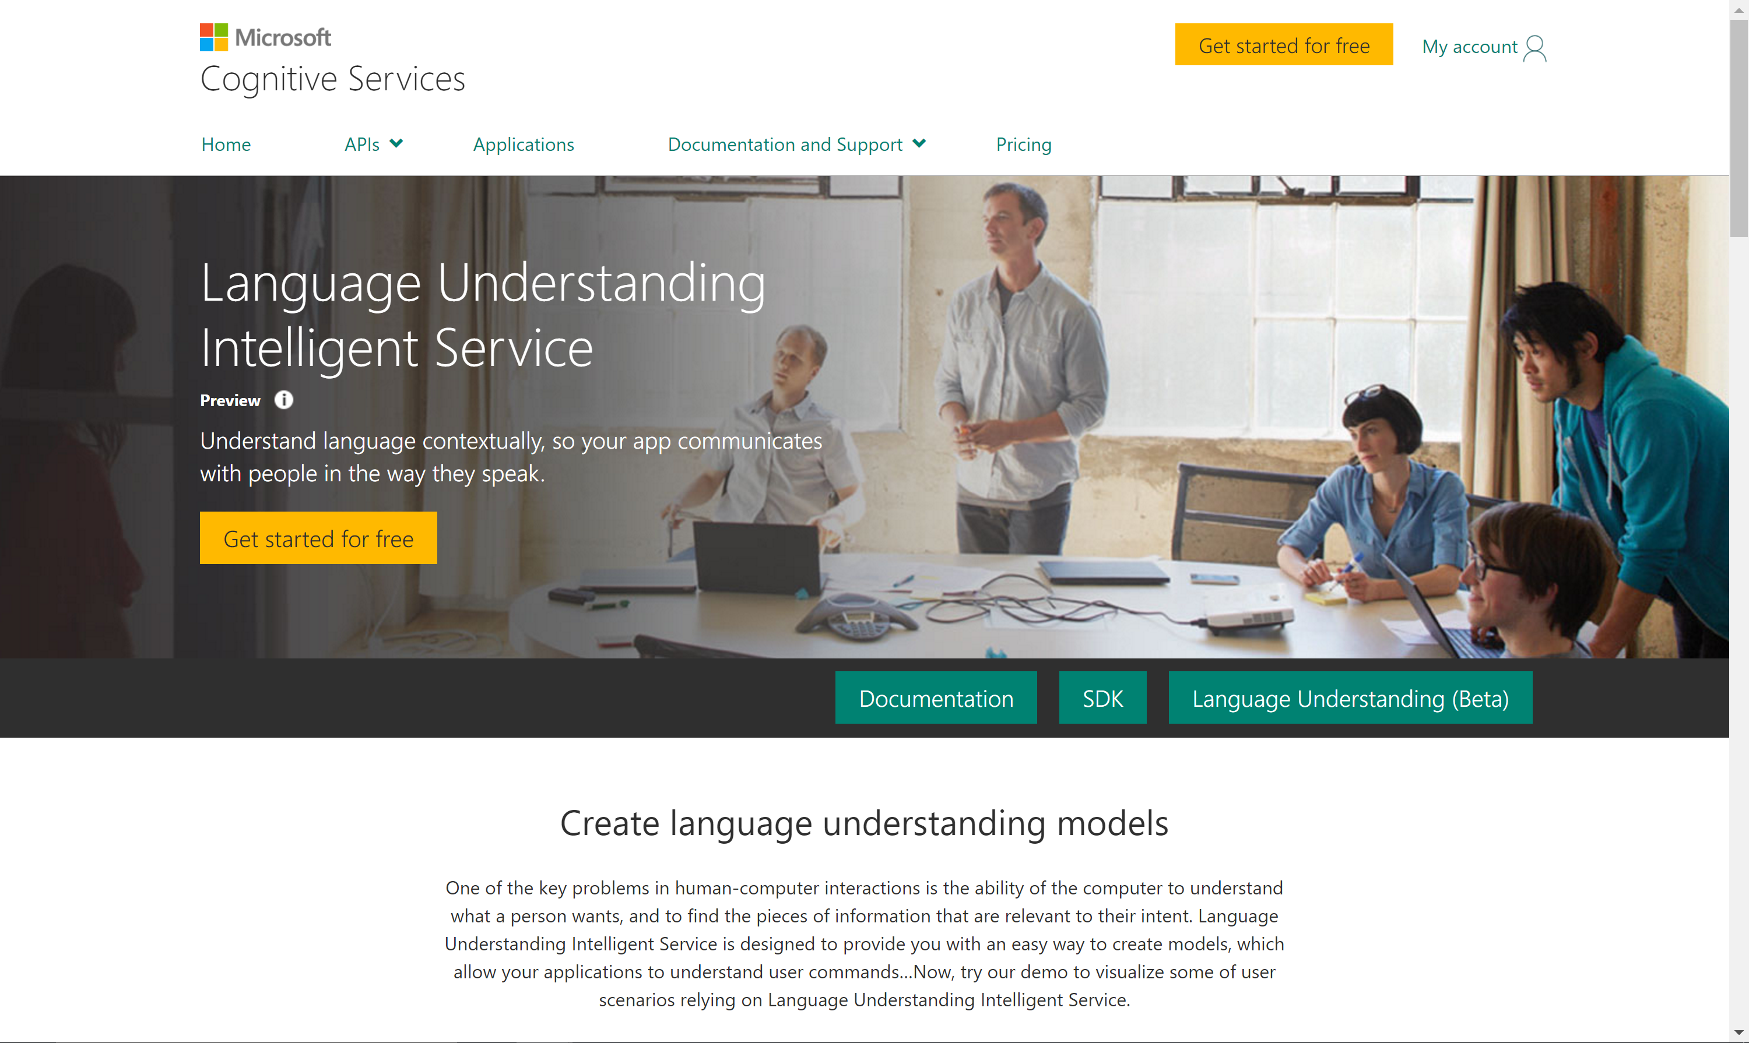

Slide 40
Determine Intent
Define Entities

Slide 41
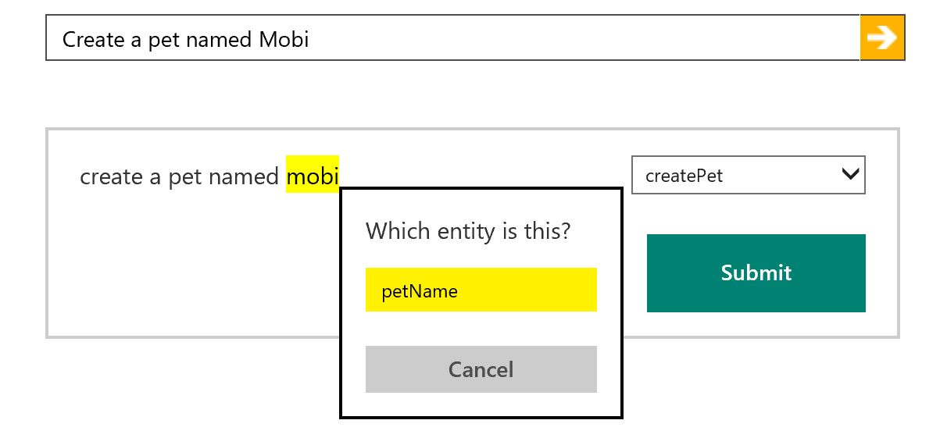
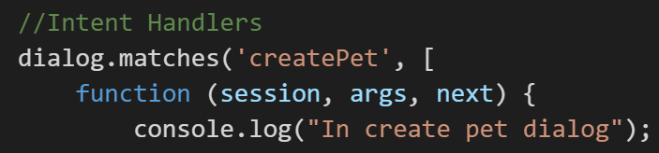
How LUIS.ai works
LUIS.ai
Language Understanding Intelligence Service
Identify entities and intents of messages
Train through GUI or programmatically
Built in LUIS intent handling in bot framework

Slide 42
Intent Recognizers
What they said
What they meant
Intent
Recognizer
Implements IIntent Interface

Slide 43
New bot developers tend to abuse NLP
A bot with a single dialog using 100 LUIS intents is a bad design:
One question
100 LUIS intents, * 100 different utterances per intent = 10000 different things users may say (plus the other 90000 possibilities you didn’t predict)
100 different things your bot can do
Users will only guess 3 or so
So you just wasted 97% of your code
Hello user! How can I help you?

Slide 44
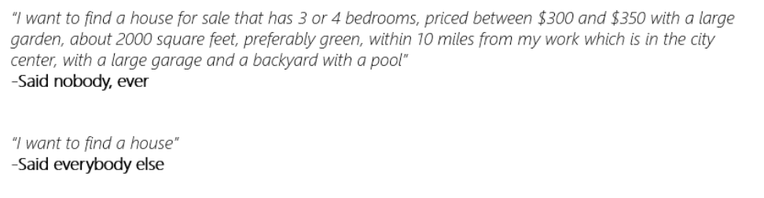
Users never say things the way you expect
As you model your NLP, make sure you’re being realistic

Slide 45
New bot developers tend to abuse NLP
So instead:
Hello user! How can I help you?
What events are you interested in?
What music would you like? (by the way, next time you could just type “I’m looking for a song named xyz” and I will know what to do)
Events
Music
Stages
Comedy
Amenities
Film
Laser Dome
Spectacles
Theater
Guide the user
Save time
Help the user discover what your bot can do

Slide 46

Directed or Non-Directed

Slide 47
Non -Directed
Directed

Slide 48
Non -Directed
Directed

Slide 49
How do I sign up?
How can you help me
Is there a warrantee?
What is a reserve price?
How long does the battery last?
I'm looking for cameras
Show me some shoes.
General Questions
Product Search
Product Details

Slide 50
Hands On LAB
Exercise 5 – Using Intent Dialogs

Slide 51
Adding Cognitive Services

Slide 52
Microsoft Cognitive Services
VISION
SPEECH
LANGUAGE
KNOWLEDGE
SEARCH
Computer Vision
Custom Speech Service (formerly CRIS)
Bing Spell Check
Academic Knowledge
Bing Autosuggest
Emotion
Speaker Recognition
Language Understanding
Entity Linking
Bing Image Search
Content Moderator
Speech
Linguistic Analysis
Knowledge Exploration
Bing News Search
Face
Translator
Text Analytics
Recommendations
Bing Video Search
Video
Web Language Model
QnA Maker
Bing Web Search

Slide 53
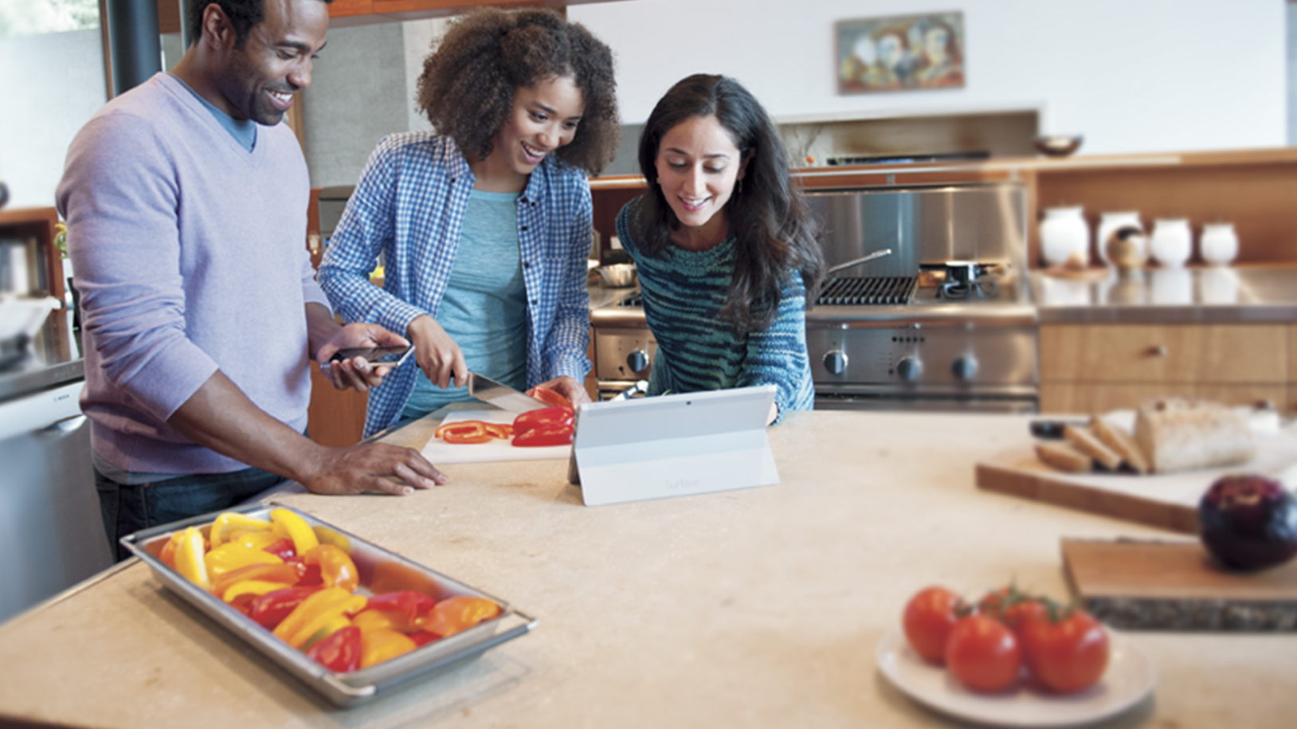
Powerful models
Cognitive Services models are trained using the same deep learning and machine learning techniques that power many products across Microsoft

Slide 54
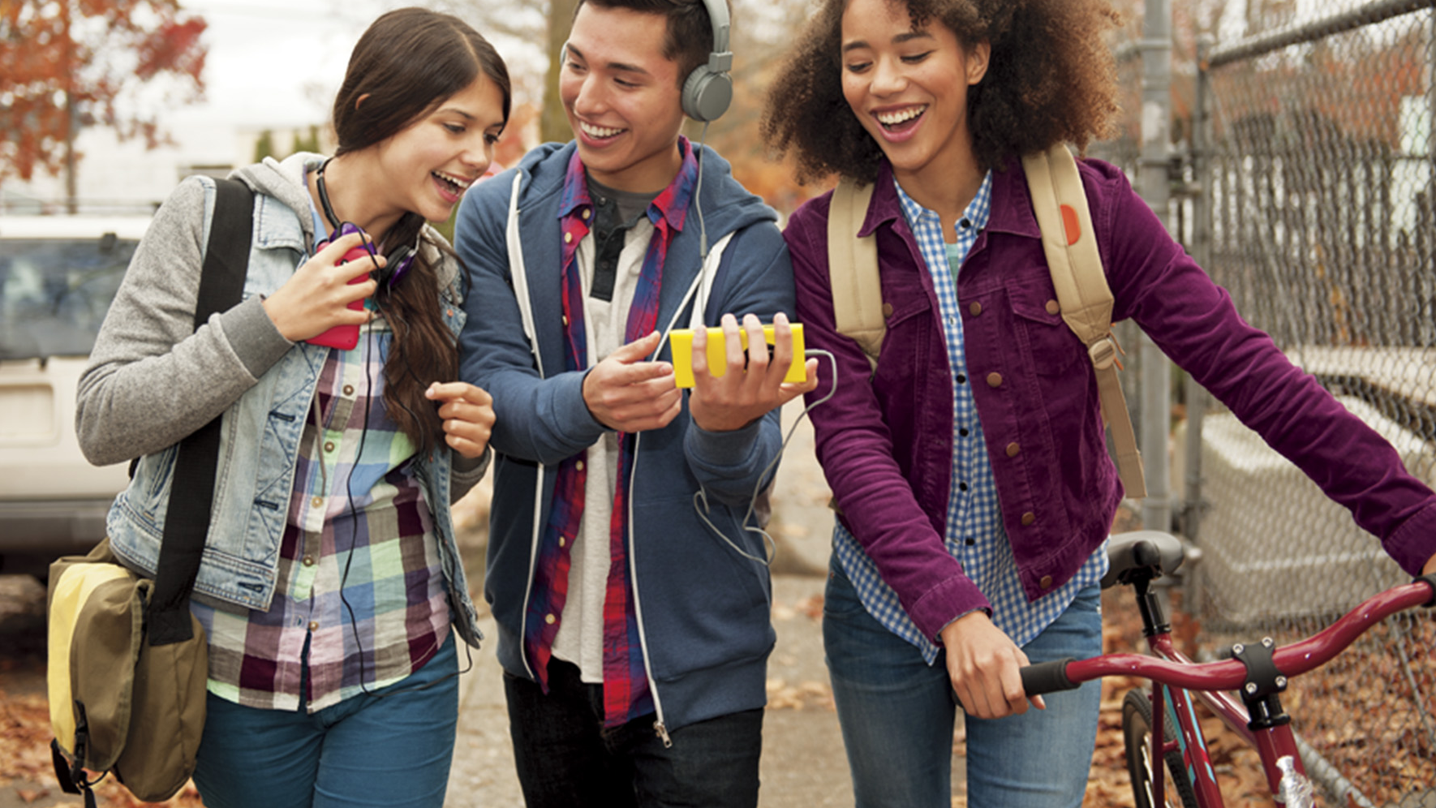
Easy to use
Microsoft Cognitive Services allows you to focus on your application by easily including these services across platforms through simple REST APIs

Slide 55
Vision
Computers that see

Slide 56
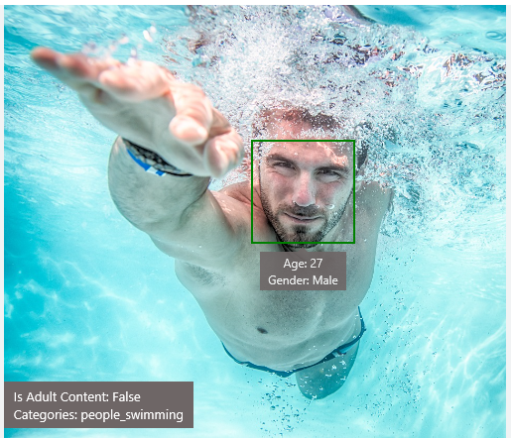
Analyze Image – Example
Type of Image:
Clip Art Type 0 Non-clipart
Line Drawing Type 0 Non-Line Drawing
Black & White Image False
Content of Image:
Categories [{ “name”: “people_swimming”, “score”: 0.099609375 }]
Adult Content False
Adult Score 0.18533889949321747
Faces [{ “age”: 27, “gender”: “Male”, “faceRectangle”: {“left”: 472, “top”: 258, “width”: 199, “height”: 199}}]
Image Colors:
Dominant Color Background White
Dominant Color Foreground Grey
Dominant Colors White
Accent Color

Slide 57

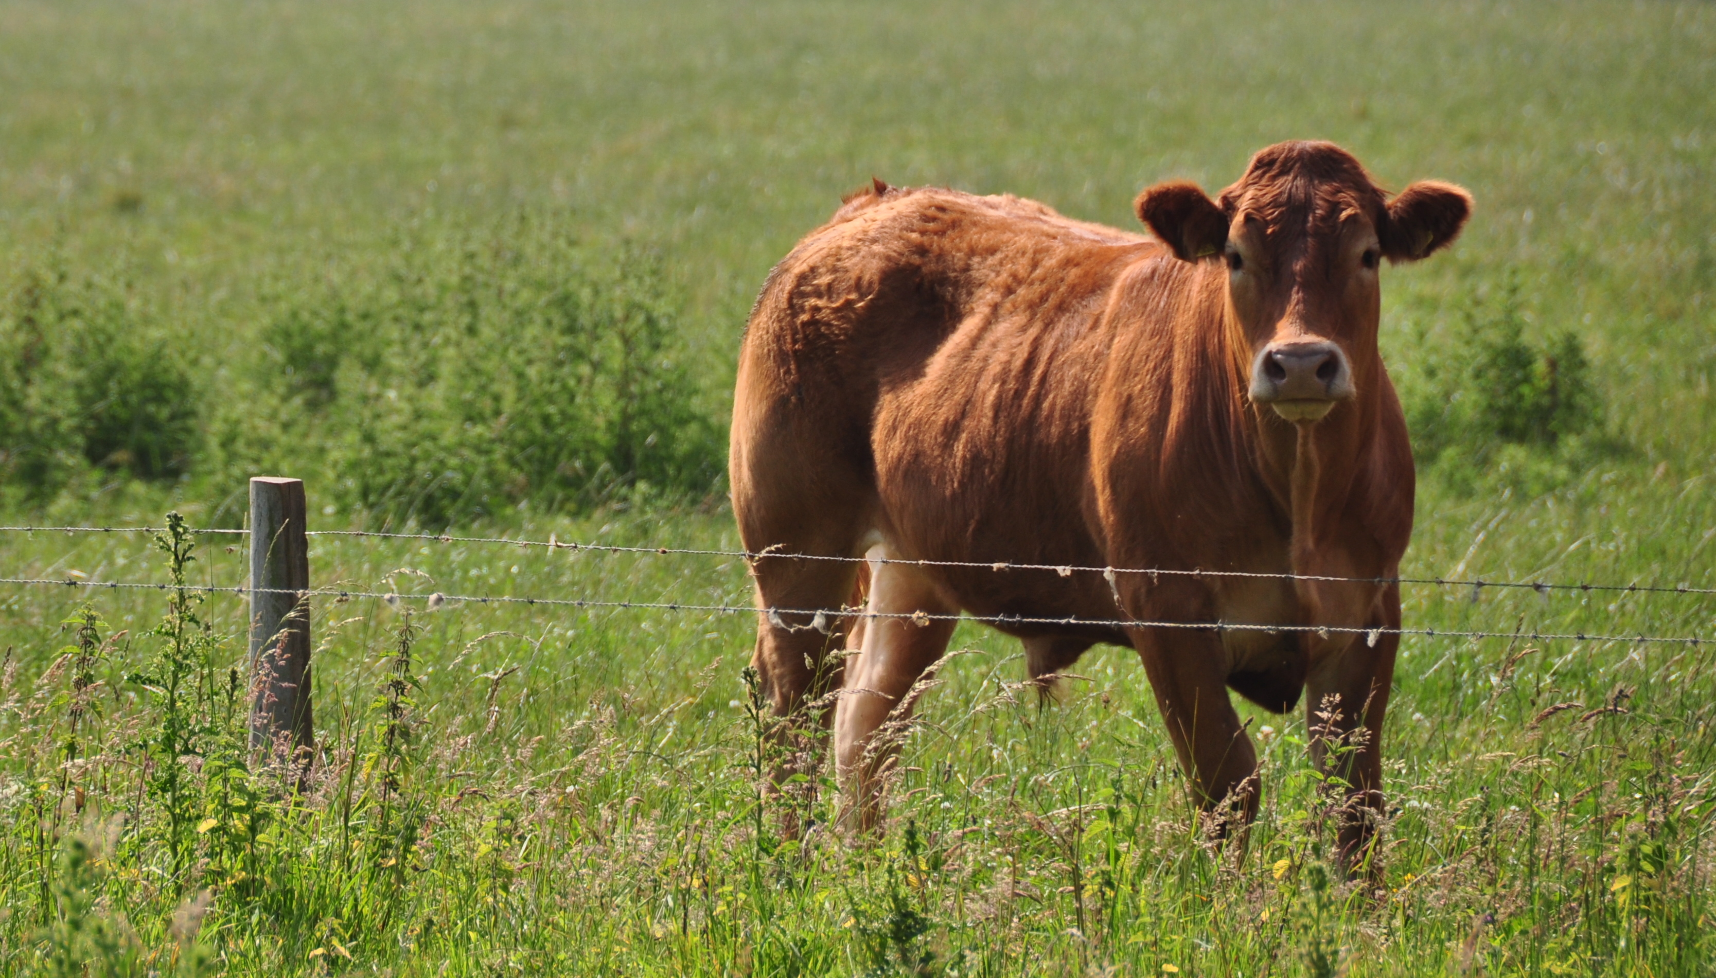
Analyze Image – Example
Categories v0: [{ “name”: “animal”, “score”: 0.9765625 }]
V1: [{ "name": "grass", "confidence": 0.9999992847442627 },
{ "name": "outdoor", "confidence": 0.9999072551727295 },
{ "name": "cow", "confidence": 0.99954754114151 },
{ "name": "field", "confidence": 0.9976195693016052 },
{ "name": "brown", "confidence": 0.988935649394989 },
{ "name": "animal", "confidence": 0.97904372215271 },
{ "name": "standing", "confidence": 0.9632768630981445 },
{ "name": "mammal", "confidence": 0.9366017580032349, "hint": "animal" },
{ "name": "wire", "confidence": 0.8946959376335144 },
{ "name": "green", "confidence": 0.8844101428985596 },
{ "name": "pasture", "confidence": 0.8332059383392334 },
{ "name": "bovine", "confidence": 0.5618471503257751, "hint": "animal" },
{ "name": "grassy", "confidence": 0.48627158999443054 },
{ "name": "lush", "confidence": 0.1874018907546997 },
{ "name": "staring", "confidence": 0.165890634059906 }]
Describe
0.975 "a brown cow standing on top of a lush green field“
0.974 “a cow standing on top of a lush green field”
0.965 “a large brown cow standing on top of a lush green field”

Slide 58
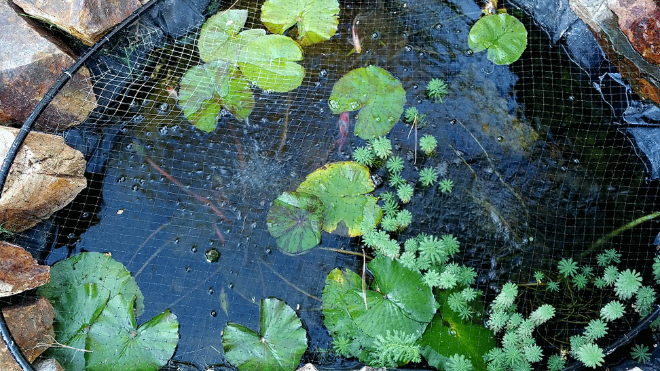
Wackcoon

Slide 59
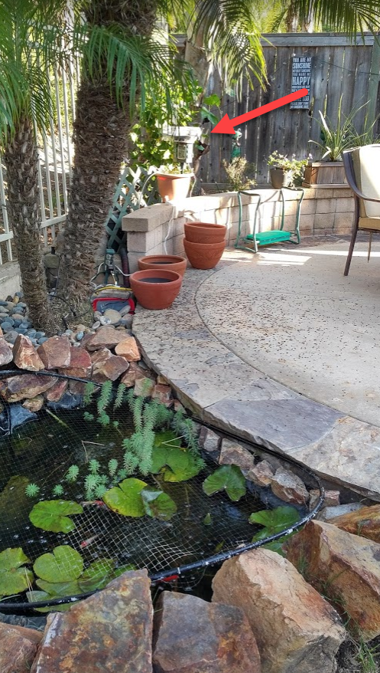
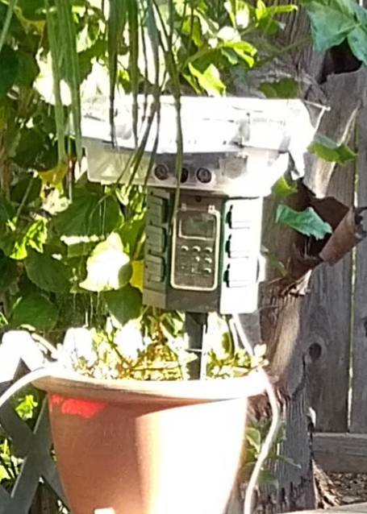
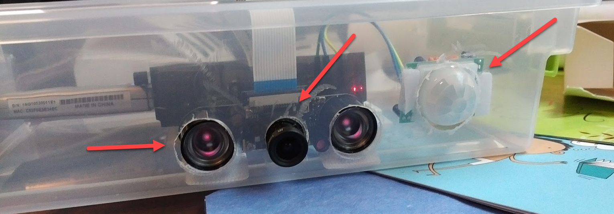
Wackcoon
Content of Image:
Categories v0: [{ “name”: “animal”, “score”: 0.9765625 }]
V1: [{ "name": "grass", "confidence": 0.9999992847442627 },
{ "name": "outdoor", "confidence": 0.9999072551727295 },
{ "name": "cat", "confidence": 0.99954754114151 },
{ "name": "raccoon", "confidence": 0.9976195693016052 },
{ "name": "grey", "confidence": 0.988935649394989 },
{ "name": "animal", "confidence": 0.97904372215271 },
{ "name": "standing", "confidence": 0.9632768630981445 },
{ "name": "mammal", "confidence": 0.9366017580032349, "hint": "animal" },
{ "name": "aquarium", "confidence": 0.8946959376335144 },
{ "name": "green", "confidence": 0.8844101428985596 },
{ "name": "grass", "confidence": 0.8332059383392334 },
{ "name": "water", "confidence": 0.5618471503257751 },
{ "name": "grassy", "confidence": 0.48627158999443054 },
{ "name": "lush", "confidence": 0.1874018907546997 },
{ "name": "staring", "confidence": 0.165890634059906 }]

Slide 60
Demo
microsoft.com/cognitive
Start coding
A simple bot using the vision API
We will go deeper about the BotFramework Later

Slide 61

Face APIs Detection
Verification
Grouping
Identification

Slide 62
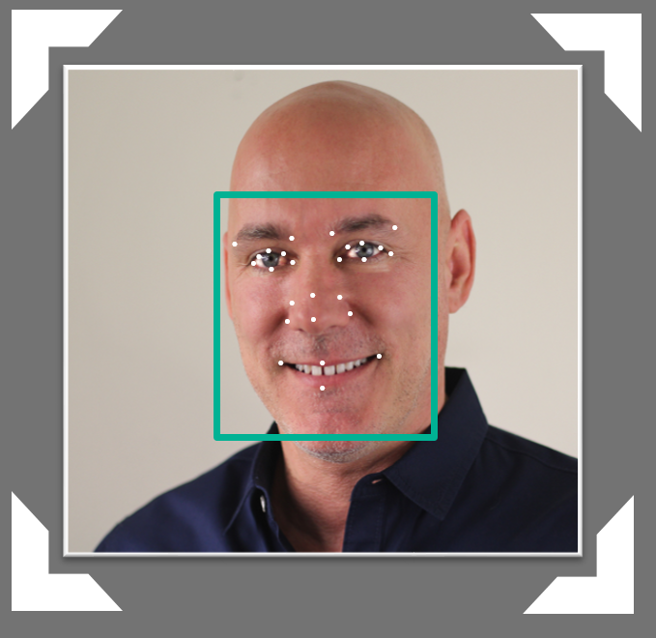

Face API – Detection
Detection Result:
JSON:
[
{
"faceRectangle": {
"width": 109,
"height": 109,
"left": 62,
"top": 62
},
"attributes": {
"age": 41,
"gender": "male",
"headPose": {
"roll": "2.9",
"yaw": "-1.3",
"pitch": "0.0"
}
"faceLandmarks": {
"pupilLeft": {
"x": "93.6",
"y": "88.2"
},
"pupilRight": {
"x": "138.4",
"y": "91.7"
},
...
DETECTION
ATTRIBUTES
INPUT IMAGE
FACIAL RECTANGLE + LANDMARKS

Slide 63
Face API – Detection
Detection Result:
JSON:
[
{
"faceRectangle": {
"width": 109,
"height": 109,
"left": 62,
"top": 62
},
"attributes": {
"age": 31,
"gender": "male",
"headPose": {
"roll": "2.9",
"yaw": "-1.3",
"pitch": "0.0"
}
"faceLandmarks": {
"pupilLeft": {
"x": "93.6",
"y": "88.2"
},
"pupilRight": {
"x": "138.4",
"y": "91.7"
},
...
.
.
.
.
.
.
.
.
.
.
.
.
.
.
.
.
.
.
.
.
.
.
.
.
.
.

Slide 64

Face API – Verification
Given two faces, determine whether they are the same person
Verification Result:
JSON:
[
{
"isIdentical":false,
"confidence":0.01
}
]
.
.
.
.
.
.
.
.
.
.
.
.
.
.

Slide 65
Demo
microsoft.com/cognitive
Start coding
Lets see the online API

Slide 66


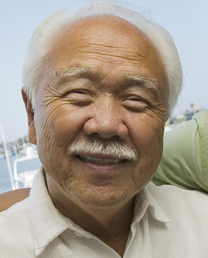

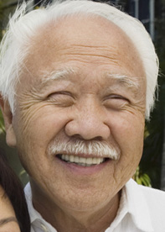

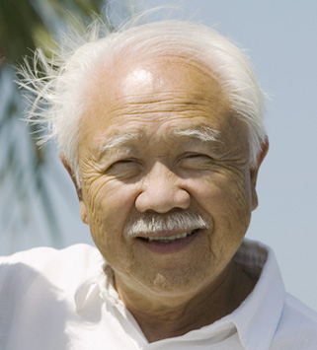

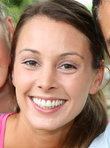

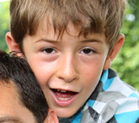

Face API – Grouping
CLUSTERED BY
DETECTED PEOPLE

Slide 67




Face API – Create Person Object
DETECTION
INPUT IMAGE
FACIAL RECTANGLE + LANDMARKS
Daniel
Egan
Daniel Egan
COLLEAGUES
COLLEAGUES
COLLEAGUES
CREATE PERSON GROUP
ADD PERSON

Slide 68
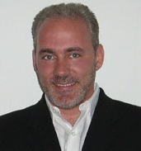


Face API – Identify
Natalie Huber
He is Daniel Egan.
IDENTIFY
GROUP PERSON OBJECTS
NEW INPUT IMAGE
RECOGNITION
Daniel Egan
COLLEAGUES

Slide 69
Publishing your Bot

Slide 70
Extras
Scorable Dialogs, Ngrok, QnA Maker ..

Slide 71
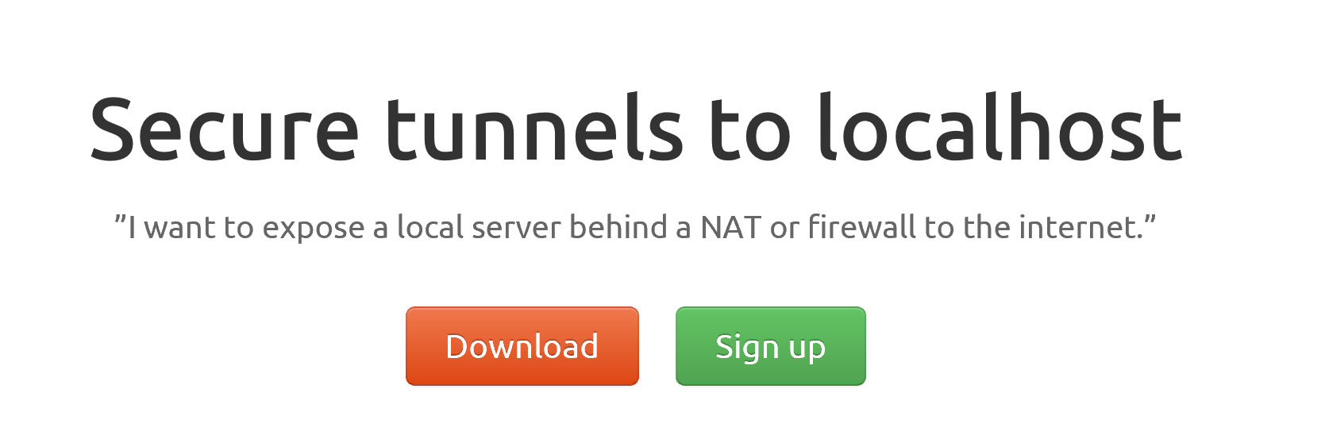
ngrok

Slide 72
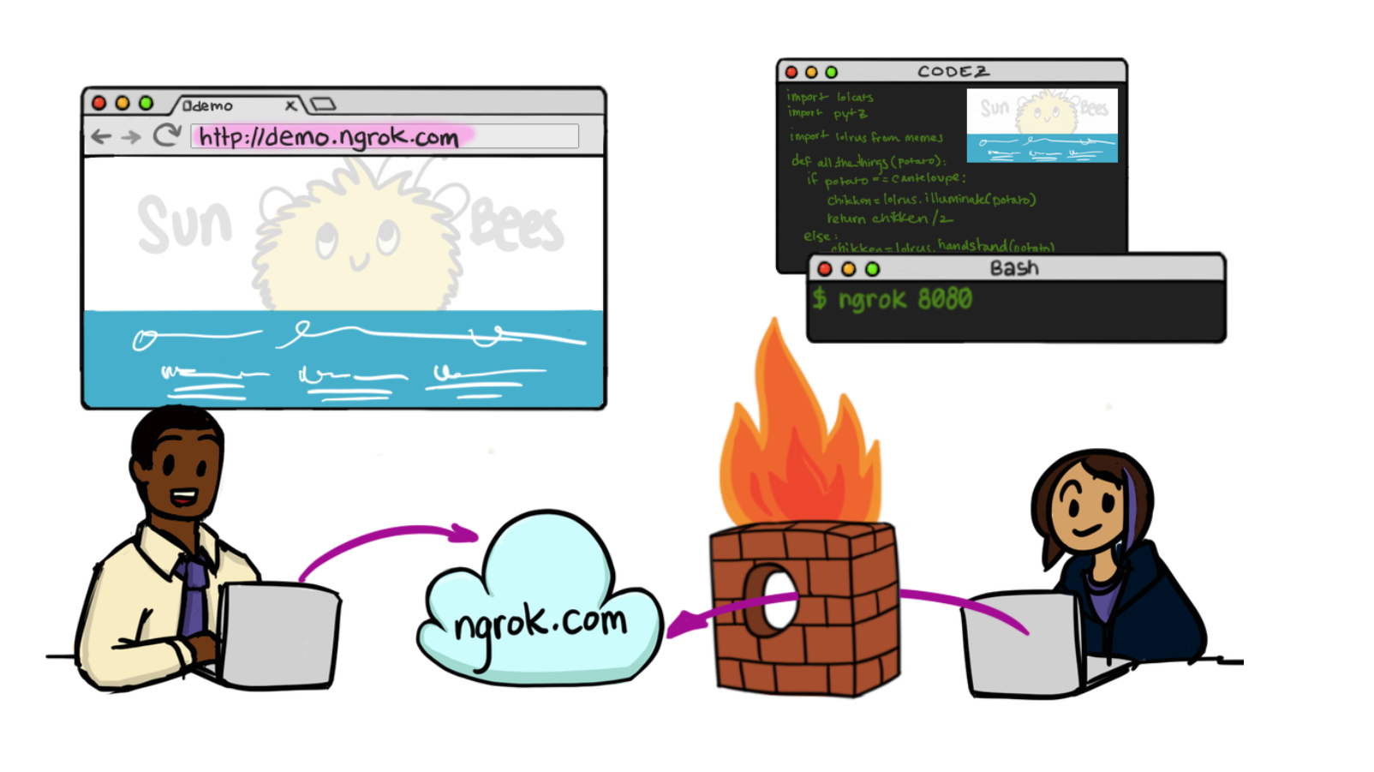

Slide 73
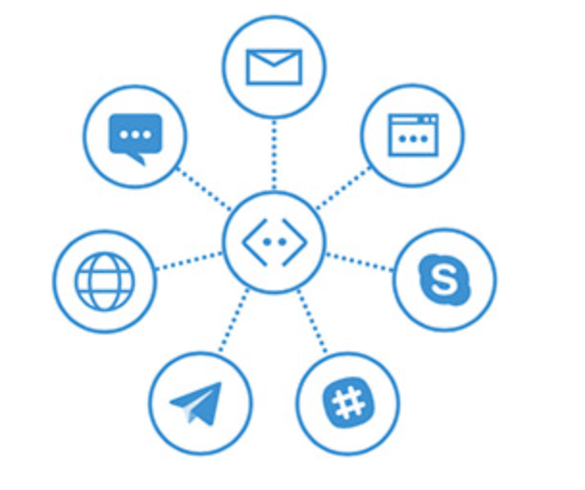
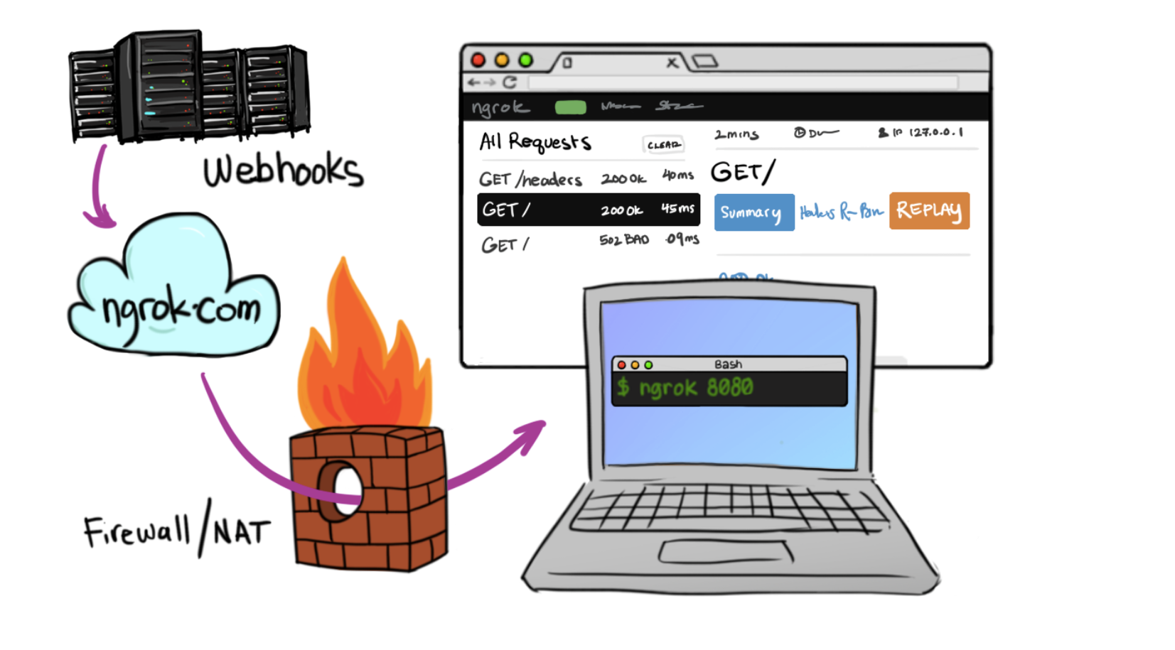
In Cloud
BotFramework

Slide 74
Additional Materials
https://docs.botframework.com/ - Bot Framework Docs
https://github.com/pveller/ecommerce-chatbot - Node – Implements IIntentInterface
https://github.com/Microsoft/BotBuilder - SDK’s has a samples folder
https://github.com/Microsoft/BotBuilder-Samples - Different Samples (Skype, Facebook, etc.)
https://www.luis.ai/Help - Training videos and HOL for LUIS
https://docs.botframework.com/en-us/tools/bot-framework-emulator/ Emulator download
http://aka.ms/bf-bc-vstemplate C# Bot Template
https://ngrok.com - Ngrok

